Slide 1
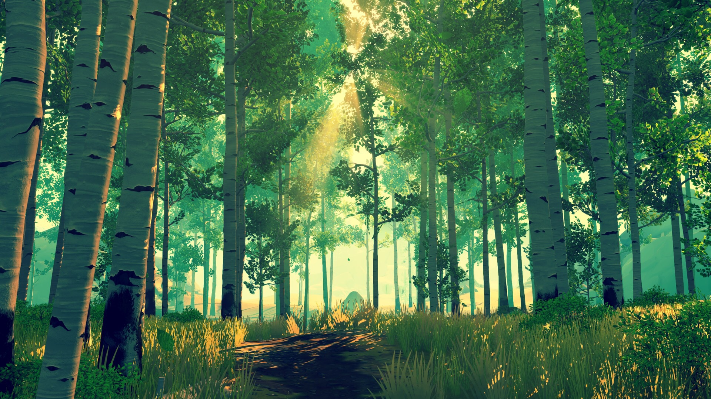
Failing Grounds
SAFE THE TREES
SAFE THE TREES
Failing Grounds

Slide 2
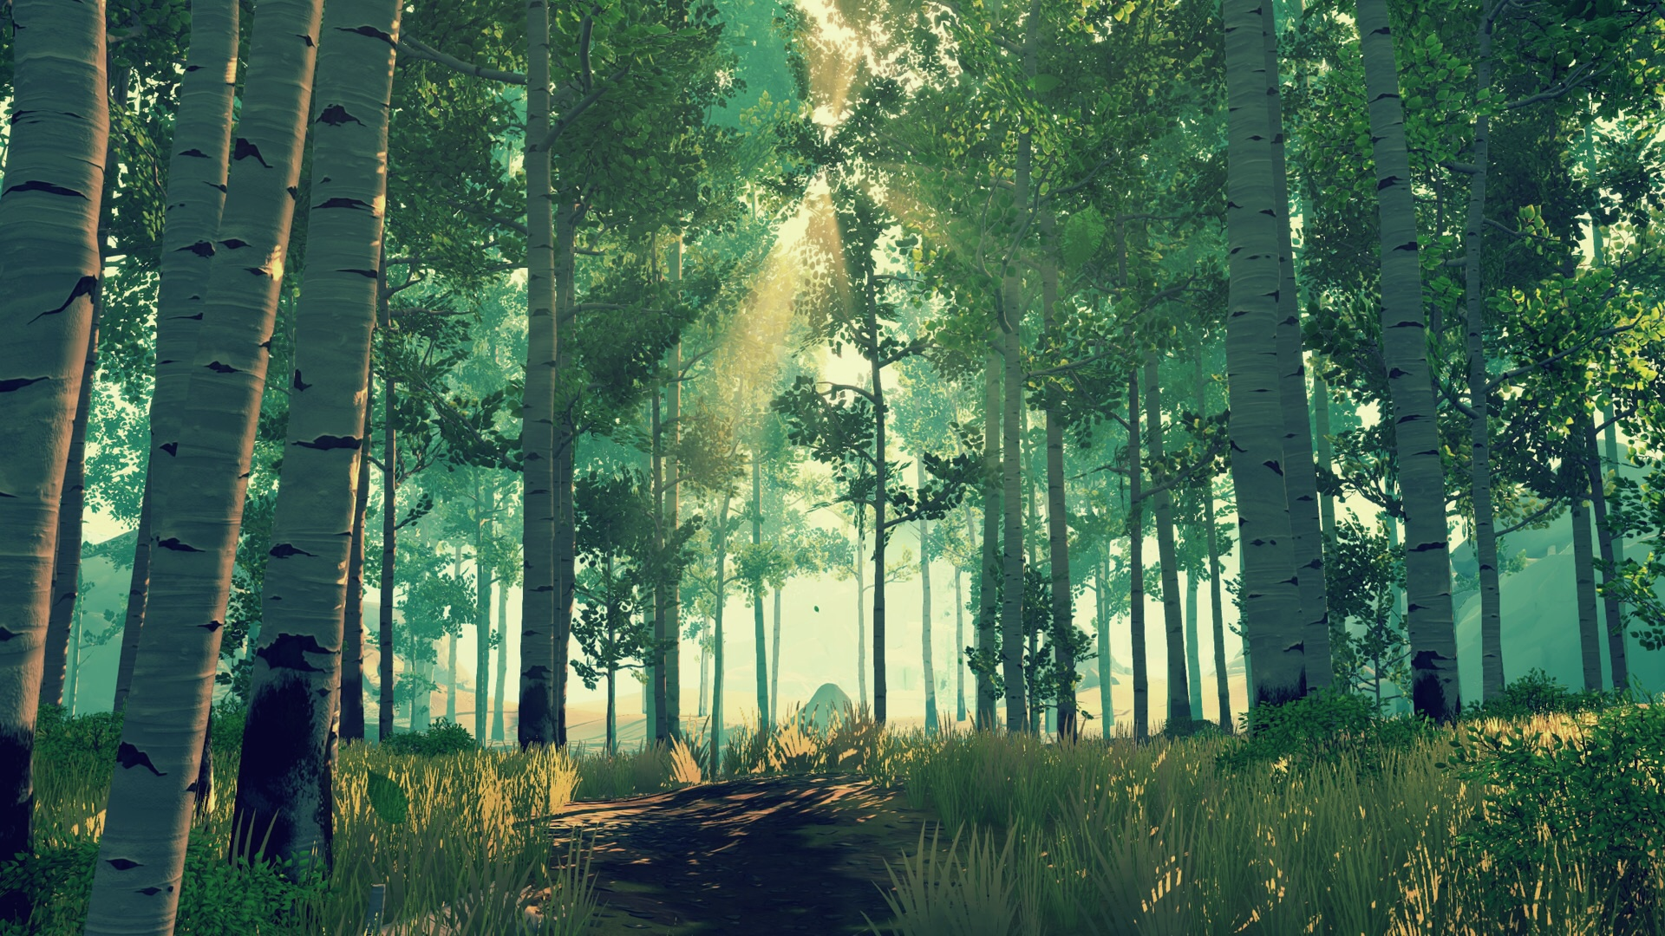
Inleiding
Wat voor game word het?
Wat is het doel?
Hoe win of verlies je?
Inleiding

Slide 3
Inleiding
Concept
Style Guide
Functioneel Ontwerp
Technisch Ontwerp
Organisatie
Planning
Inleiding

Slide 4
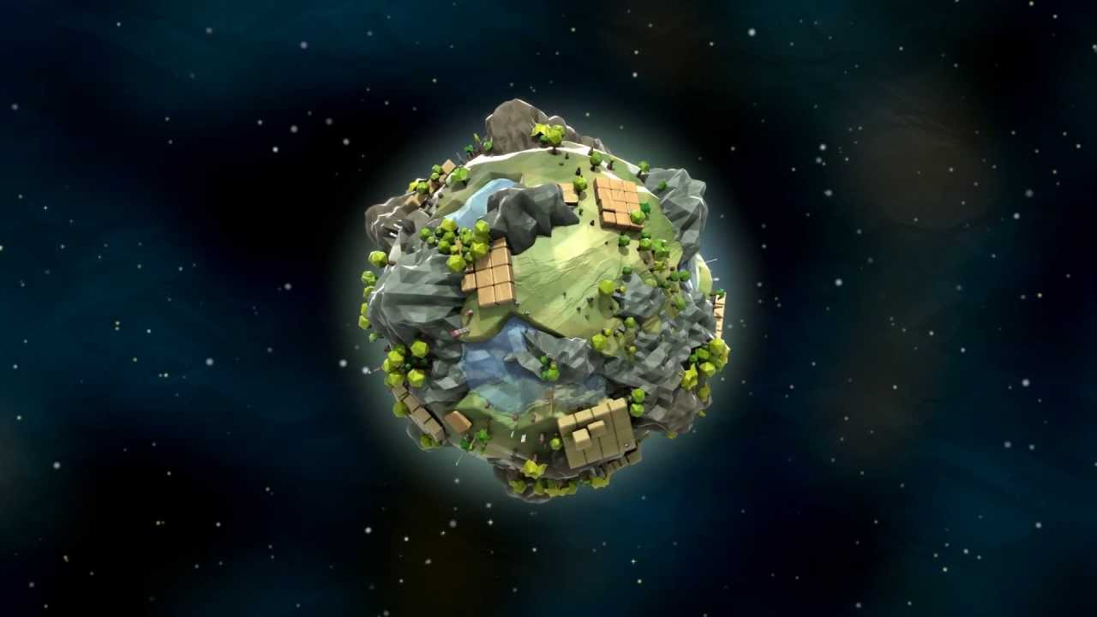
Concept
Concept
Narrative
Scope
Progression

Slide 5

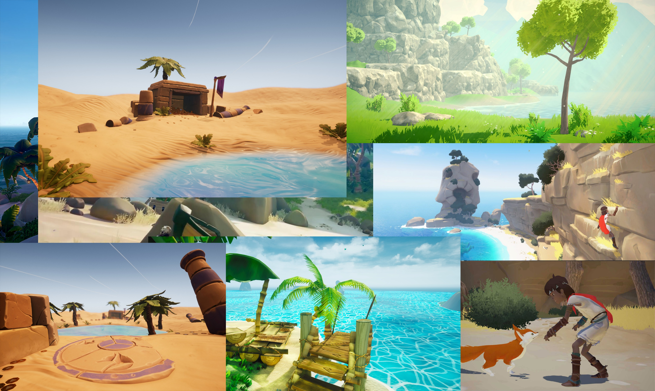
ArtStyle
Inspiratie
Setting
Style Guide
Style Guide

Slide 6
Poly Count
Texture Resolution
Amount Of Detail
Resource Budget
Resource Budget

Slide 7
Camera Movement
Player Movement
Player Abilities
Level Design
Enemies
Player Abilities
GUI
Functioneel Ontwerp
Functioneel Ontwerp

Slide 8
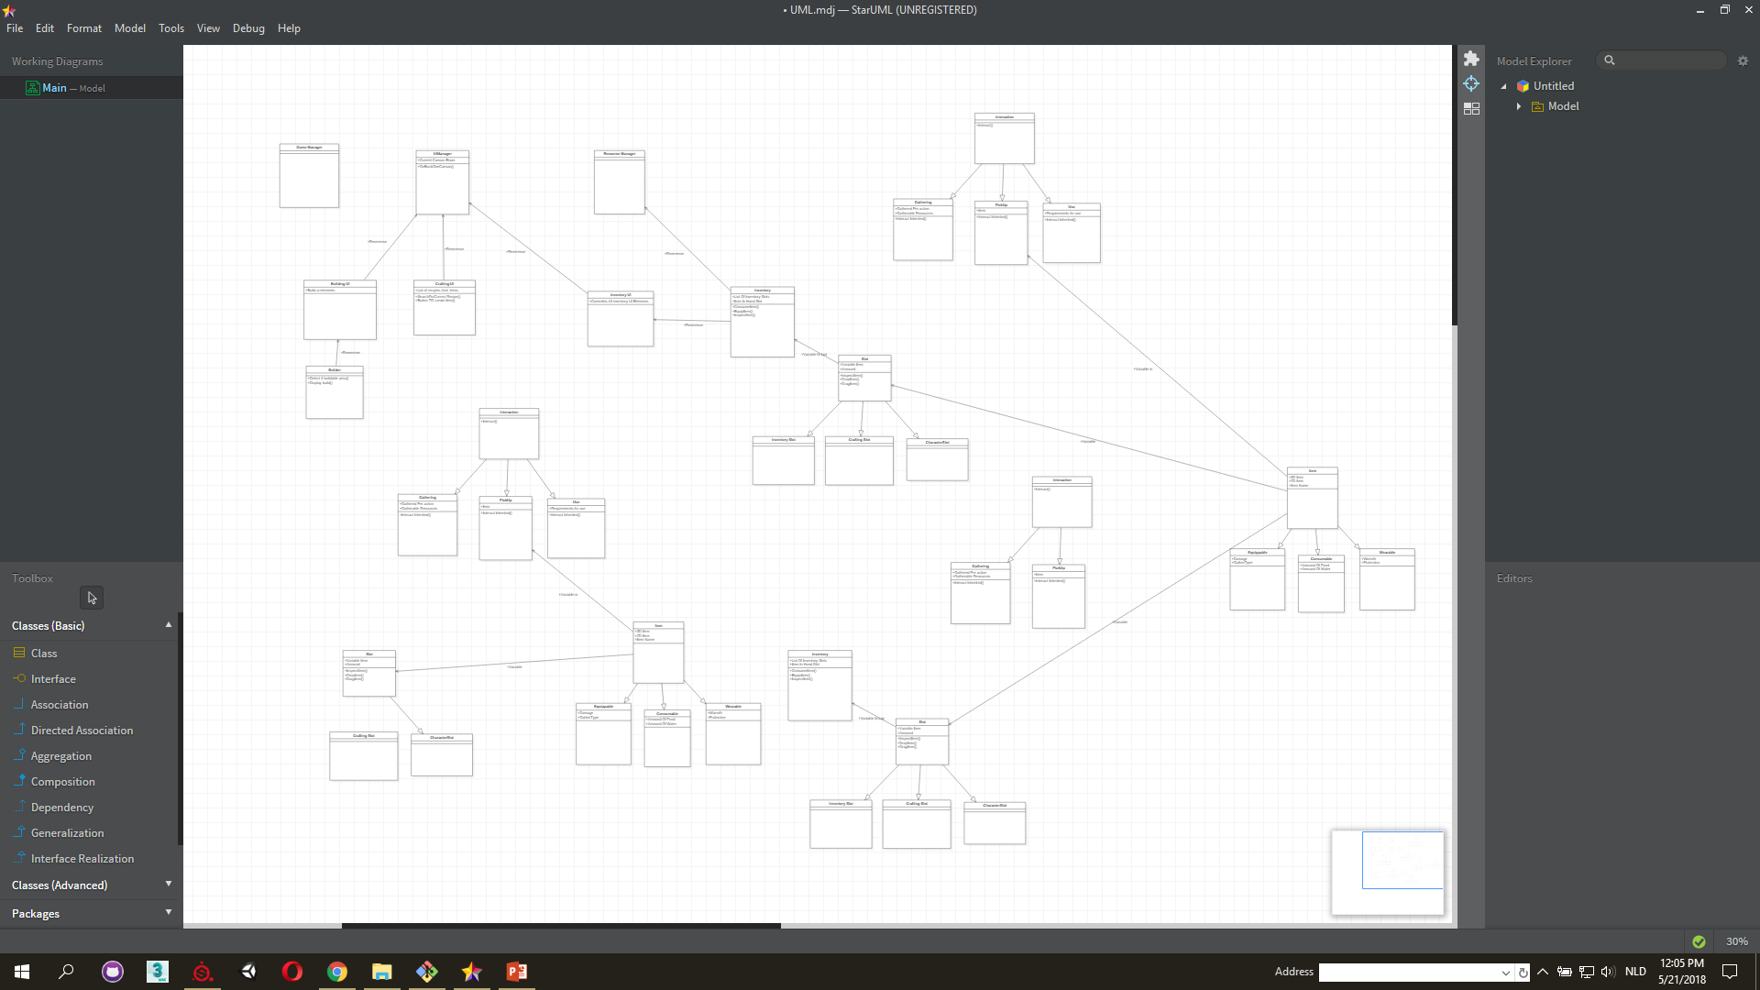

Camera Movement
Player Movement
Enemies
Player Abilities
GUI
Technisch
Ontwerp
Technisch
Ontwerp

Slide 9

Naming Conventions
Repository
Sources
Organisatie
Organisatie

Slide 10
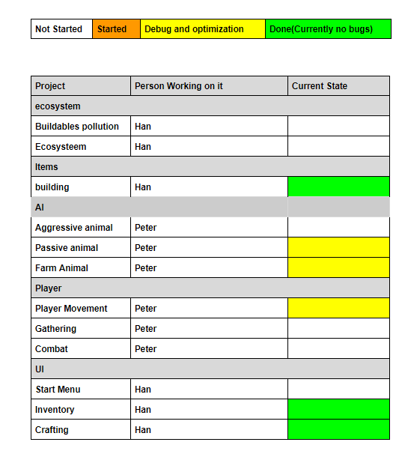
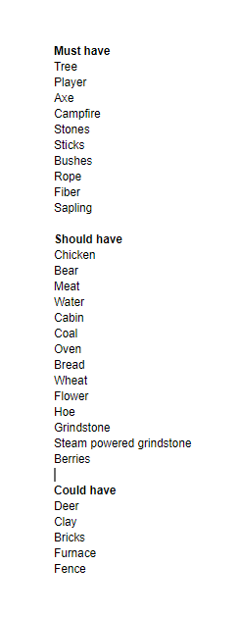
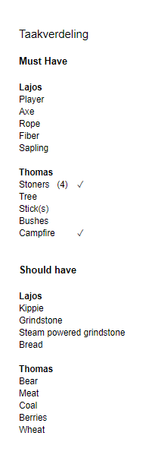
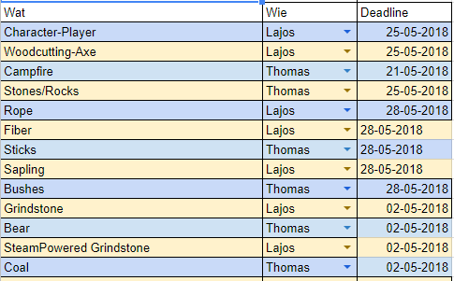
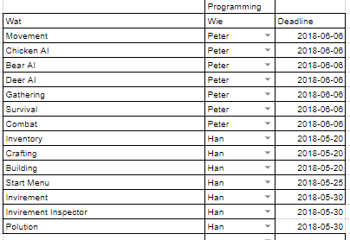
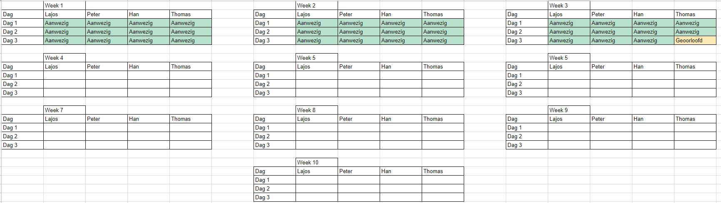
Rolverdeling
Uren Planning
Aanwezigheid
Planning
Planning

Slide 11


